Slide 1
The singular value decomposition
Kenneth D. Harris
17/6/15

Slide 2
Dimensionality reduction
Often the data we record is high dimensional.
Often the interesting structure is contained in a low dimensional subspace.
SVD is one way to reduce dimensions.
It is simple, unique (basically), and optimal (by its own criterion).
Usually the first dimensionality reduction method to try.

Slide 3
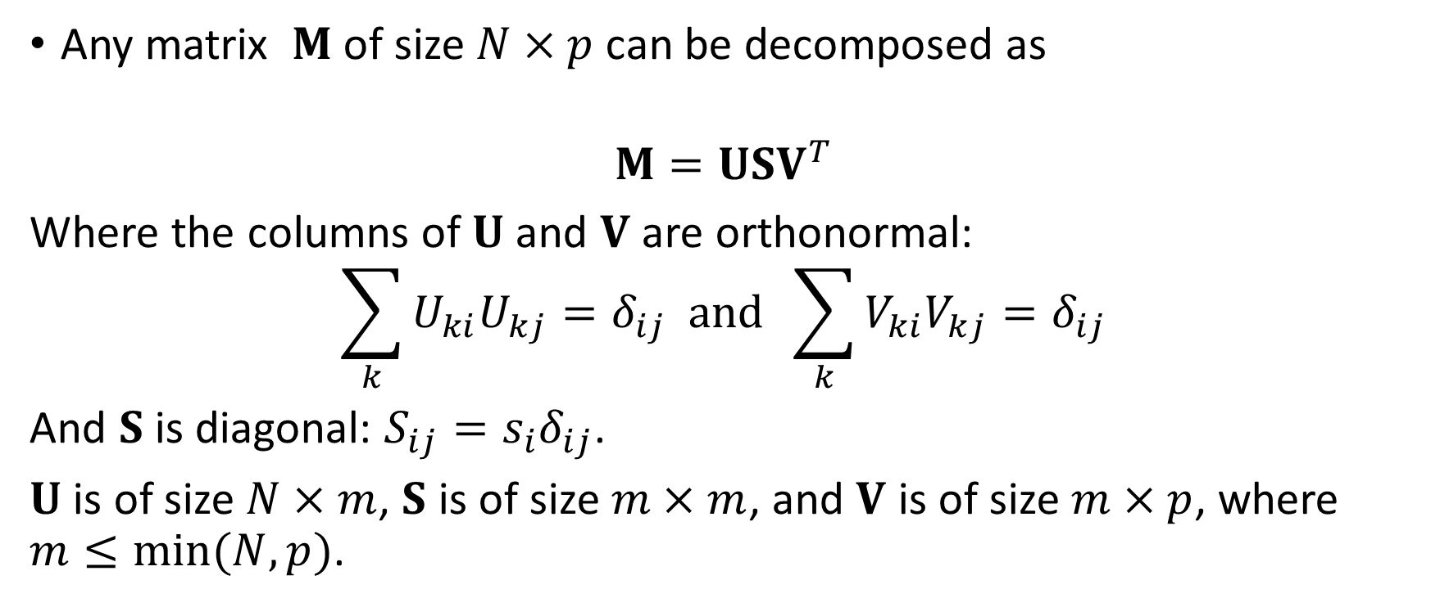
The singular value decomposition
Any matrix $M$ of size $N×p$ can be decomposed as
$$M=USV^{T}$$
Where the columns of $U$ and $V$ are orthonormal:
$$\sum_{k}{U_{ki}U_{kj}}=δ_{ij} and \sum_{k}{V_{ki}V_{kj}}=δ_{ij}$$
And $S$ is diagonal: $S_{ij}=s_{i}δ_{ij}$.
$U$ is of size $N×m$, $S$ is of size $m×m$, and $V$ is of size $m×p$, where $m≤min⁡(N,p)$.

Slide 4
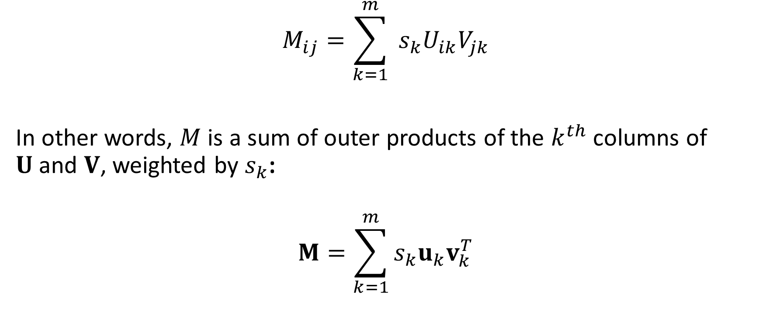
Another way to write it
$$M_{ij}=\sum_{k=1}^{m}{{{ s}_{k}U}_{ik}V_{jk}}$$
In other words, $M$ is a sum of outer products of the $k^{th}$ columns of $U$and $V$, weighted by $s_{k}$:
$$M=\sum_{k=1}^{m}{s_{k}u_{k}v_{k}^{T}}$$

Slide 5
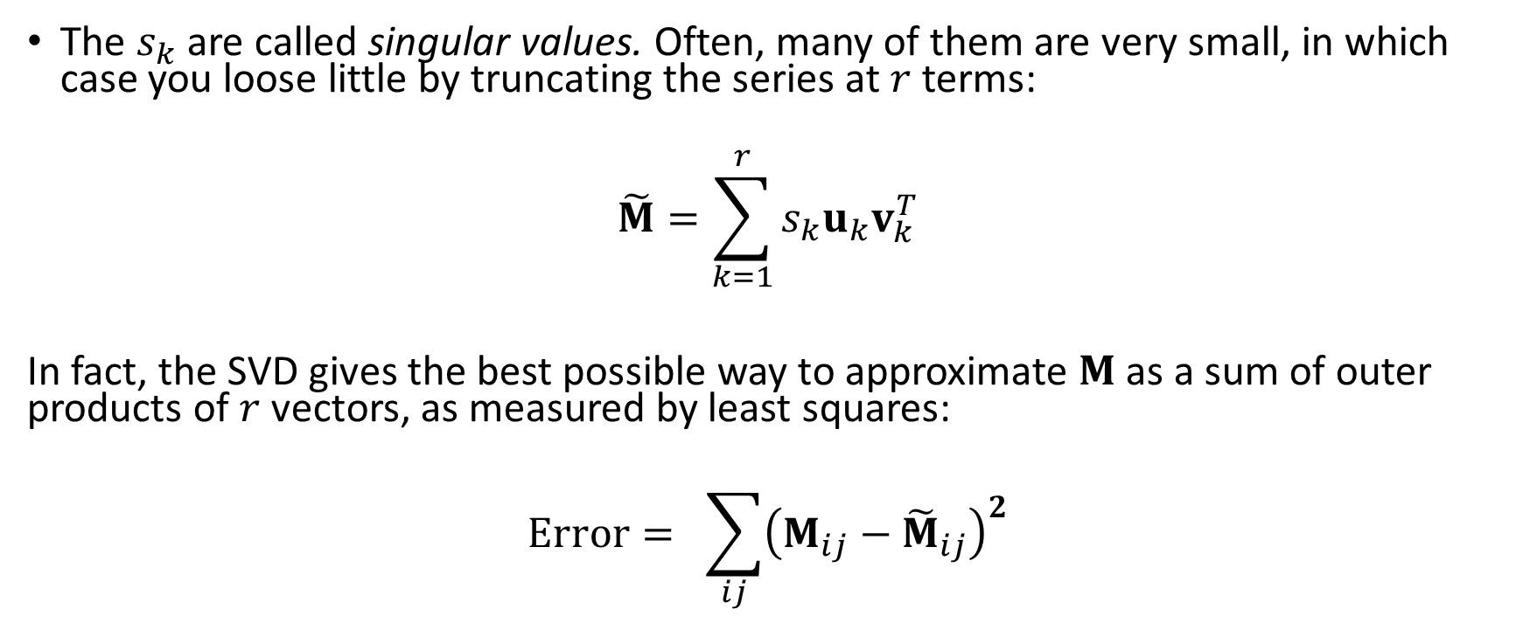
Singular values
The $s_{k}$ are called singular values. Often, many of them are very small, in which case you loose little by truncating the series at $r$ terms:
$$\tilde{M}=\sum_{k=1}^{r}{s_{k}u_{k}v_{k}^{T}}$$
In fact, the SVD gives the best possible way to approximate $M$ as a sum of outer products of $r$ vectors, as measured by least squares:
$$Error= \sum_{ij}{{\left(M_{ij}−{\tilde{M}}_{ij}\right)}^{2}}$$

Slide 6
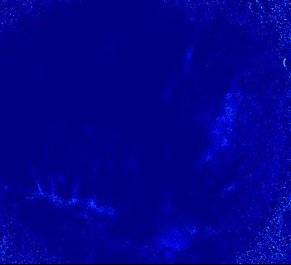
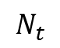
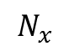
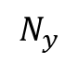
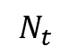
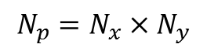
Example: compression and denoising a movie
$${N_{p}=N_{x}×N}_{y}$$
$$N_{y}$$
$$N_{x}$$
$$N_{t}$$
$$N_{t}$$
GCaMP6f, cortex
Elina Jacobs

Slide 7
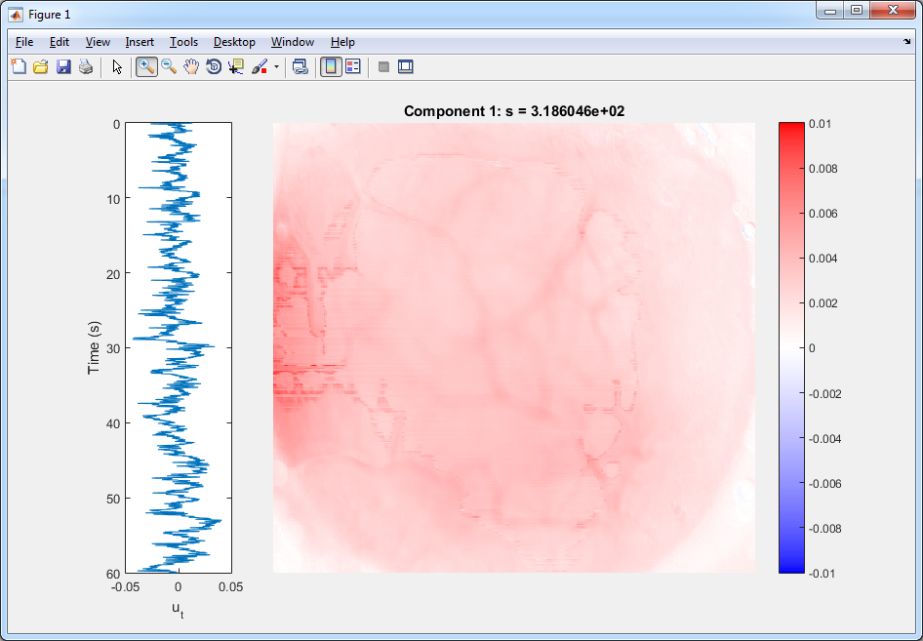

Slide 8
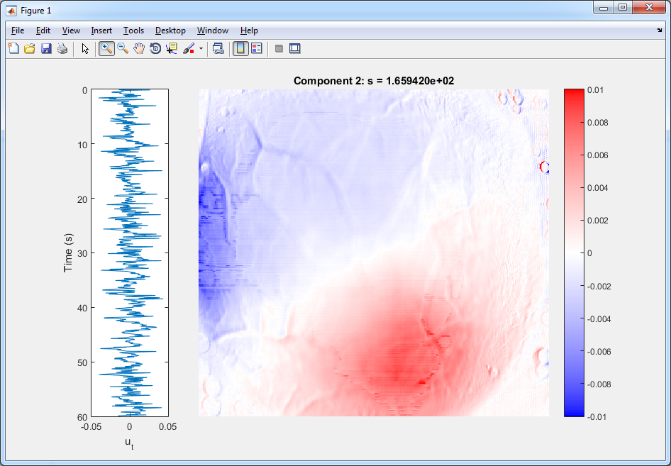

Slide 9
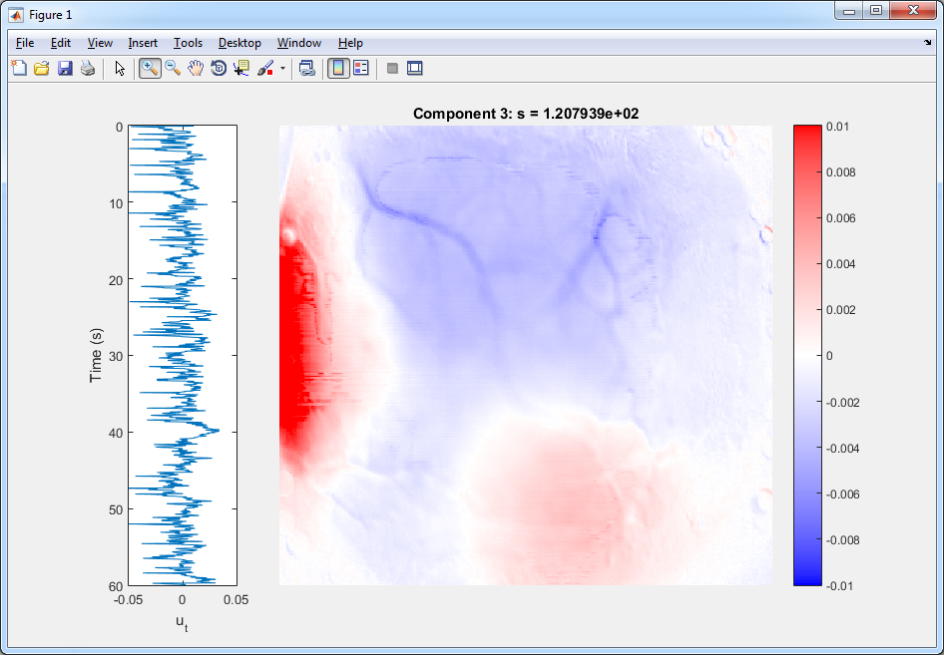

Slide 10
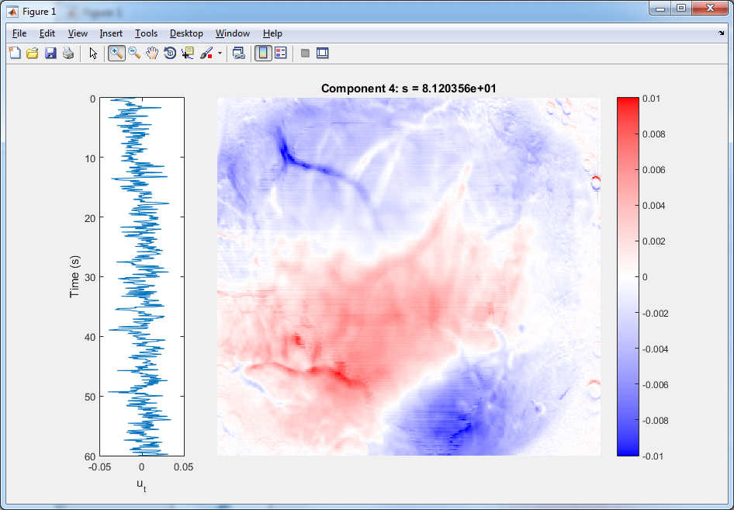

Slide 11
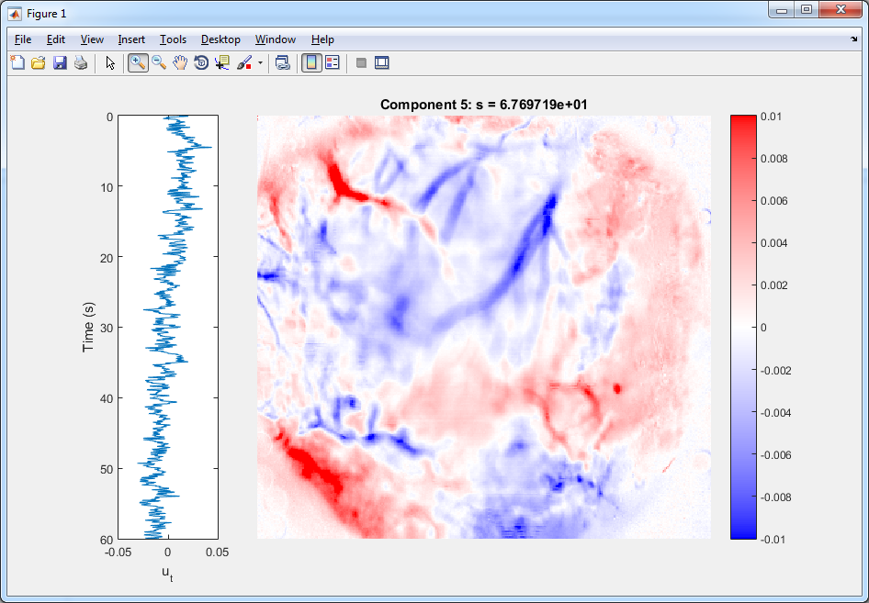

Slide 12
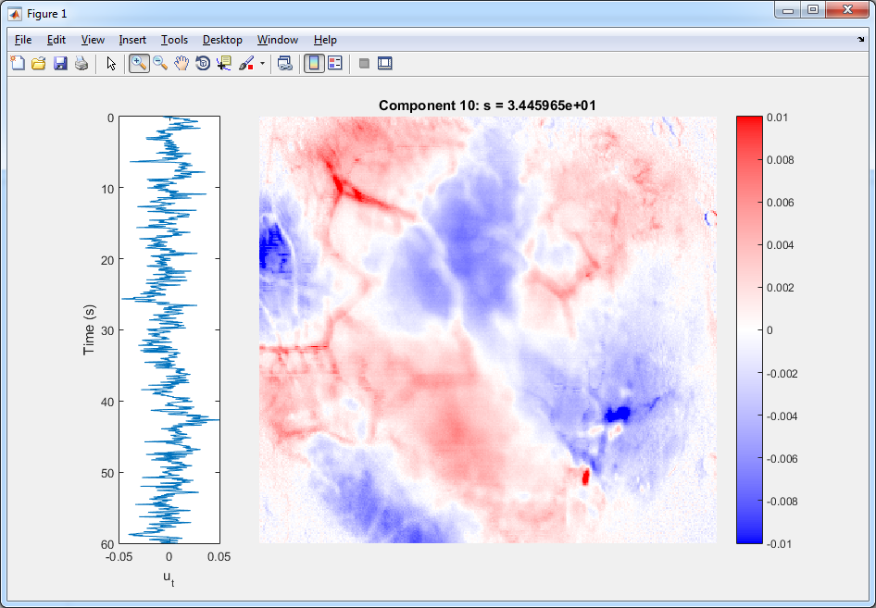

Slide 13
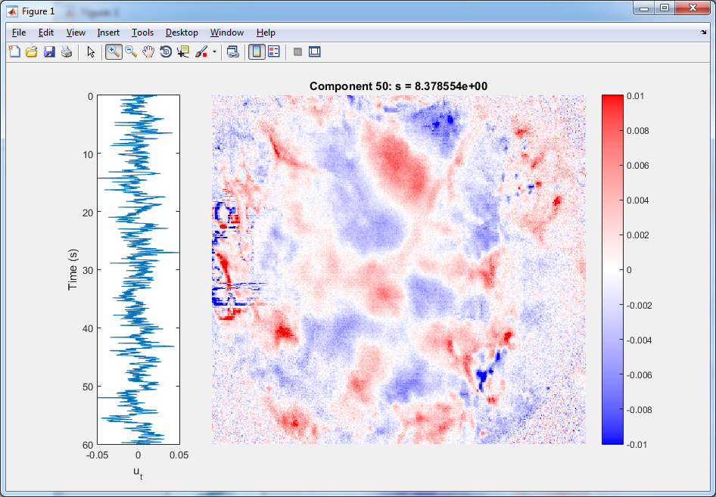

Slide 14
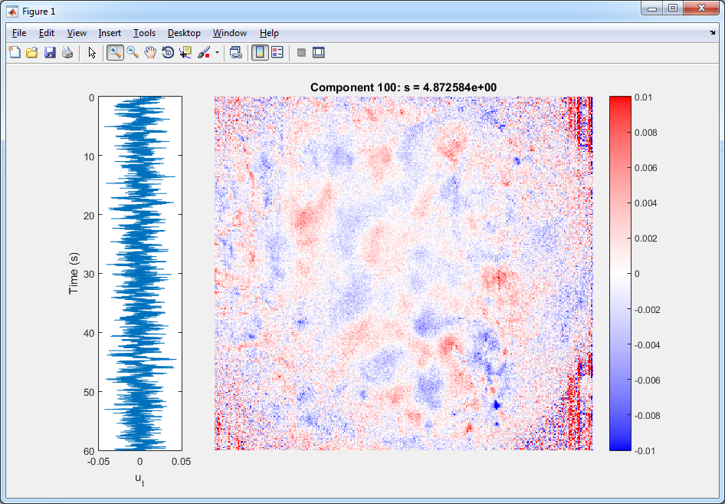

Slide 15
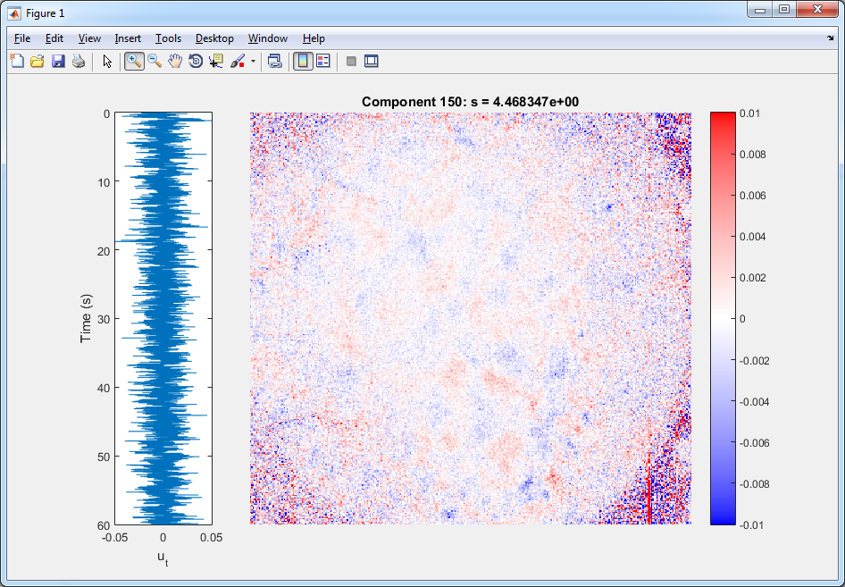

Slide 16
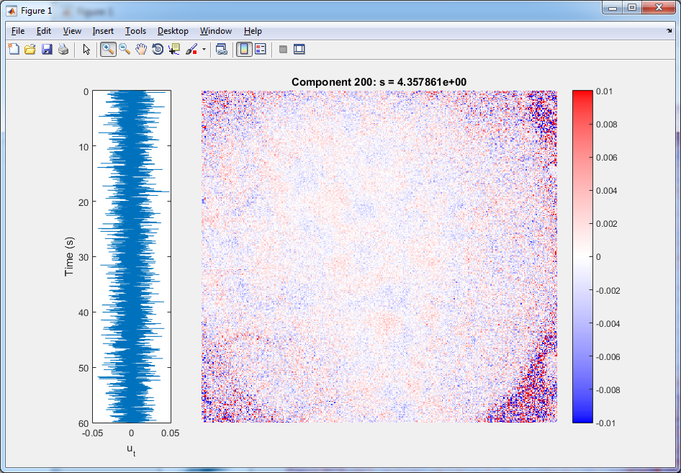

Slide 17
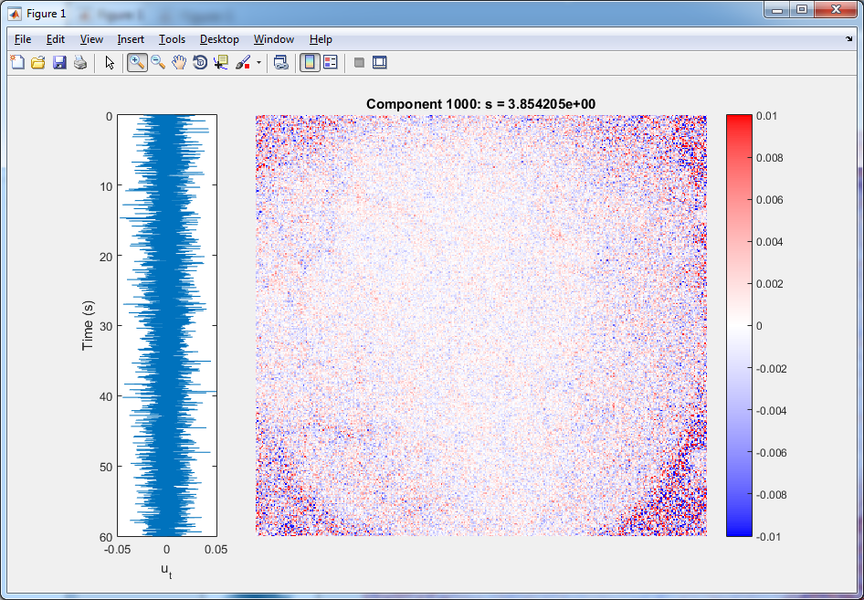

Slide 18
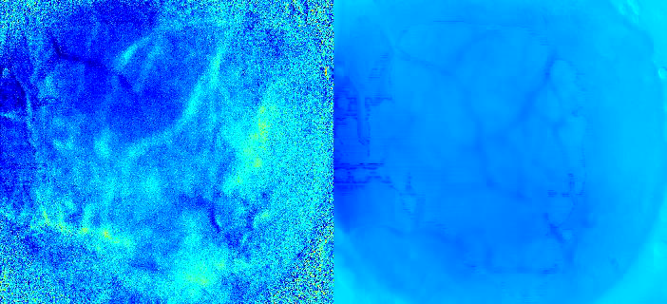
Reconstruct movie from first 1 component

Slide 19
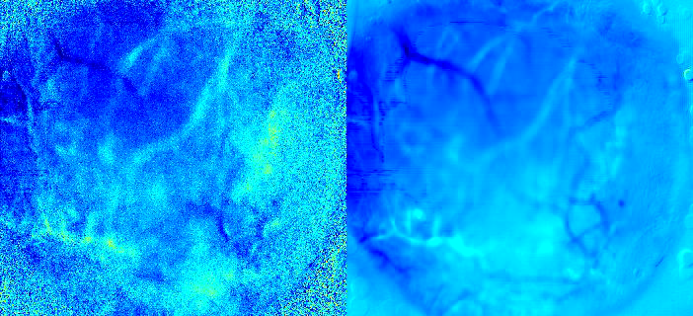
Reconstruct movie from first 5 components

Slide 20
Reconstruct movie from first 10 components

Slide 21
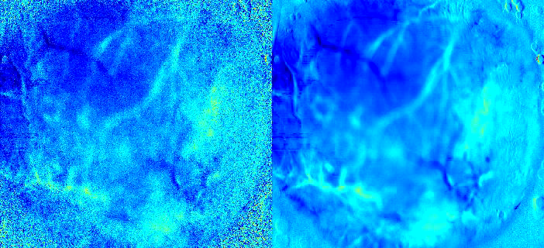
Reconstruct movie from first 100 components

Slide 22

Reconstruct movie from first 1000 components

Slide 23
SVD has compressed and denoised the image
100-component reconstruction takes 1,000 times less memory
Looks the same to the naked eye, just less noisy.
Nearly all the bits in the original movie were encoding the precise noise pattern
This only works because there are static features (i.e. cortical areas which don’t move).

Slide 24
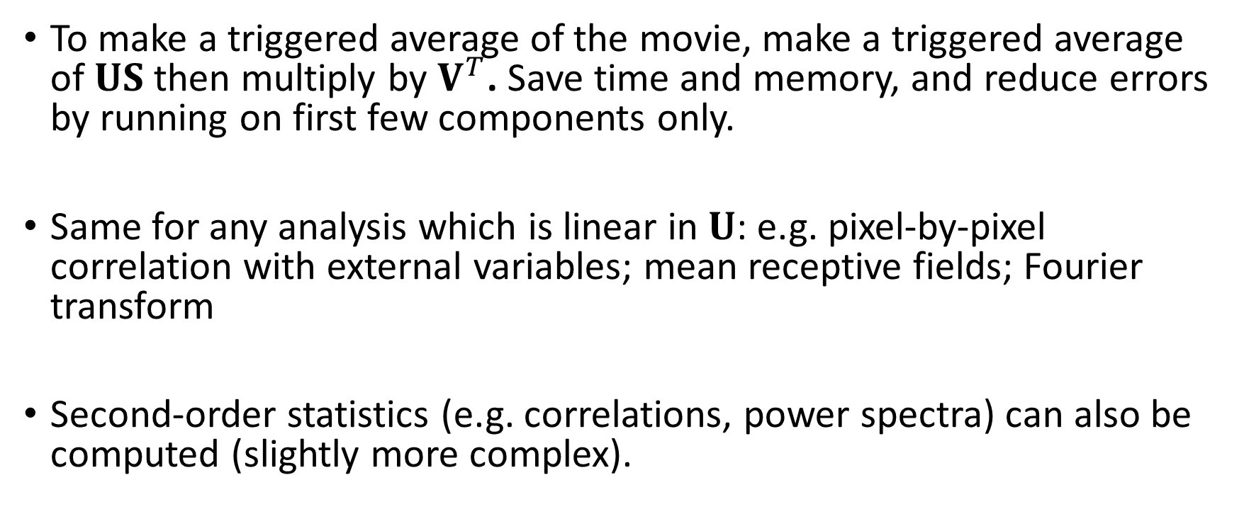
Analysis of compressed movie
To make a triggered average of the movie, make a triggered average of $US$ then multiply by $V^{T}$. Save time and memory, and reduce errors by running on first few components only.
Same for any analysis which is linear in $U$: e.g. pixel-by-pixel correlation with external variables; mean receptive fields; Fourier transform
Second-order statistics (e.g. correlations, power spectra) can also be computed (slightly more complex).

Slide 25
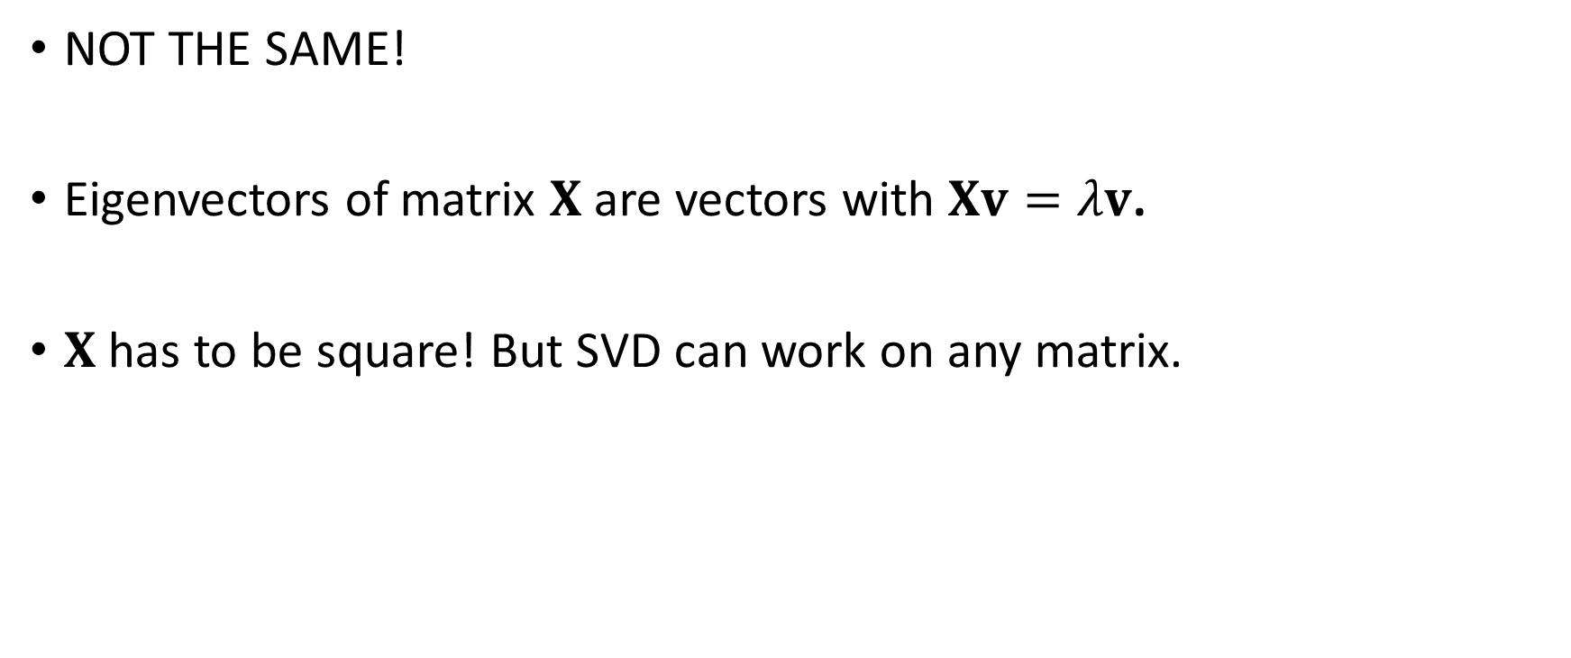
Singular values vs. eigenvalues
NOT THE SAME!
Eigenvectors of matrix $X$ are vectors with $Xv=λv$.
$X$ has to be square! But SVD can work on any matrix.

Slide 26
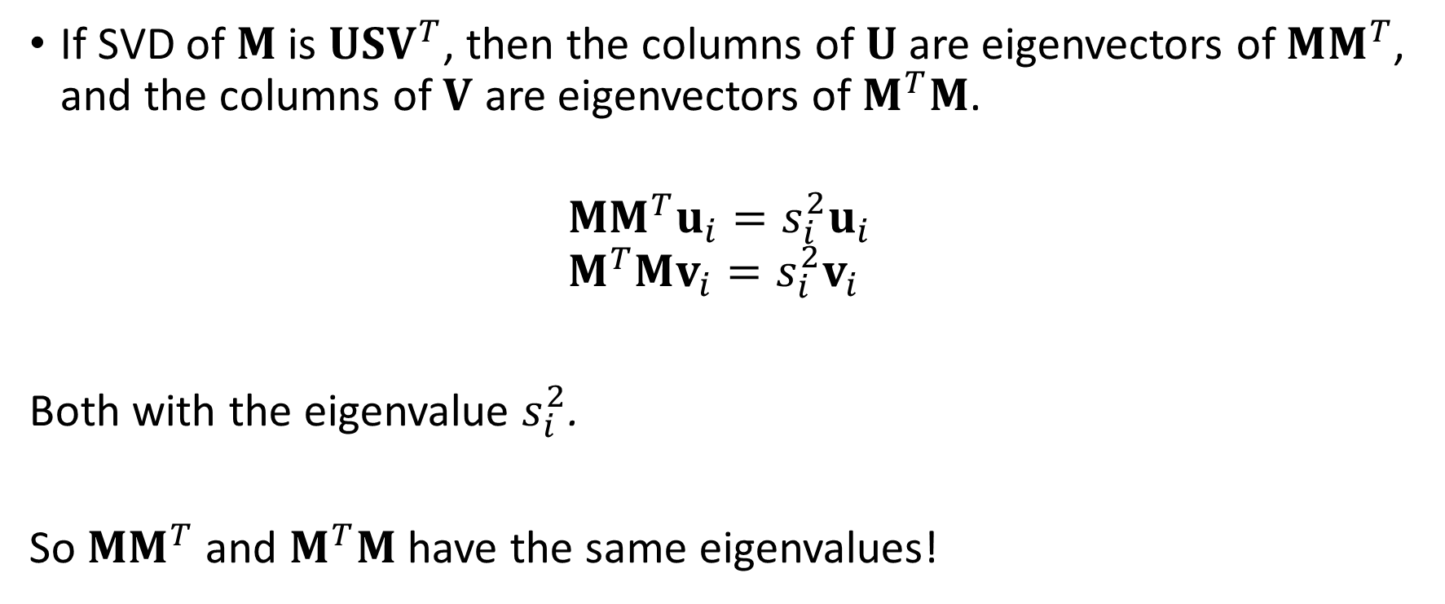
Singular values vs. eigenvalues: part 2
If SVD of $M$ is $USV^{T}$, then the columns of $U$ are eigenvectors of $MM^{T}$, and the columns of $V$ are eigenvectors of $M^{T}M$.
$$MM^{T}u_{i}=s_{i}^{2}u_{i} \\ M^{T}Mv_{i}=s_{i}^{2}v_{i}$$
Both with the eigenvalue $s_{i}^{2}$.
So $MM^{T}$ and $M^{T}M$ have the same eigenvalues!

Slide 27
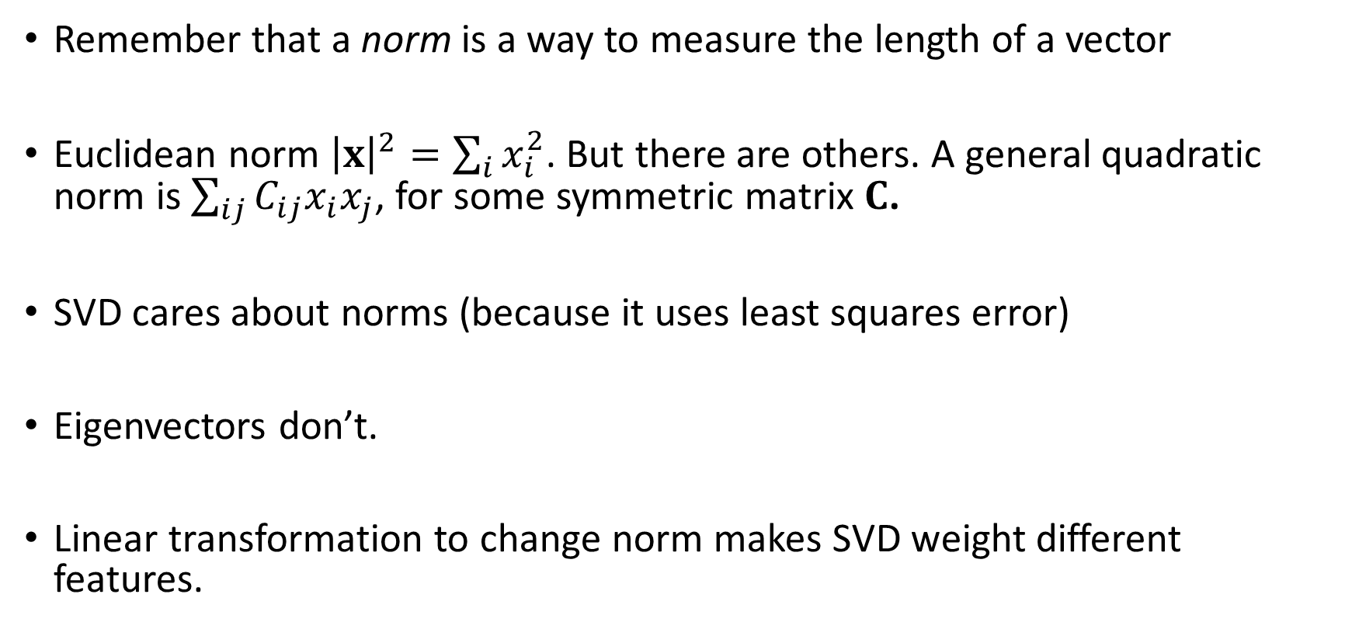
Singular values vs. eigenvalues: part 3
Remember that a norm is a way to measure the length of a vector
Euclidean norm ${\left|x\right|}^{2}=\sum_{i}{x_{i}^{2}}$. But there are others. A general quadratic norm is $\sum_{ij}{C_{ij}x_{i}x_{j}}$, for some symmetric matrix $C$.
SVD cares about norms (because it uses least squares error)
Eigenvectors don’t.
Linear transformation to change norm makes SVD weight different features.

Slide 28
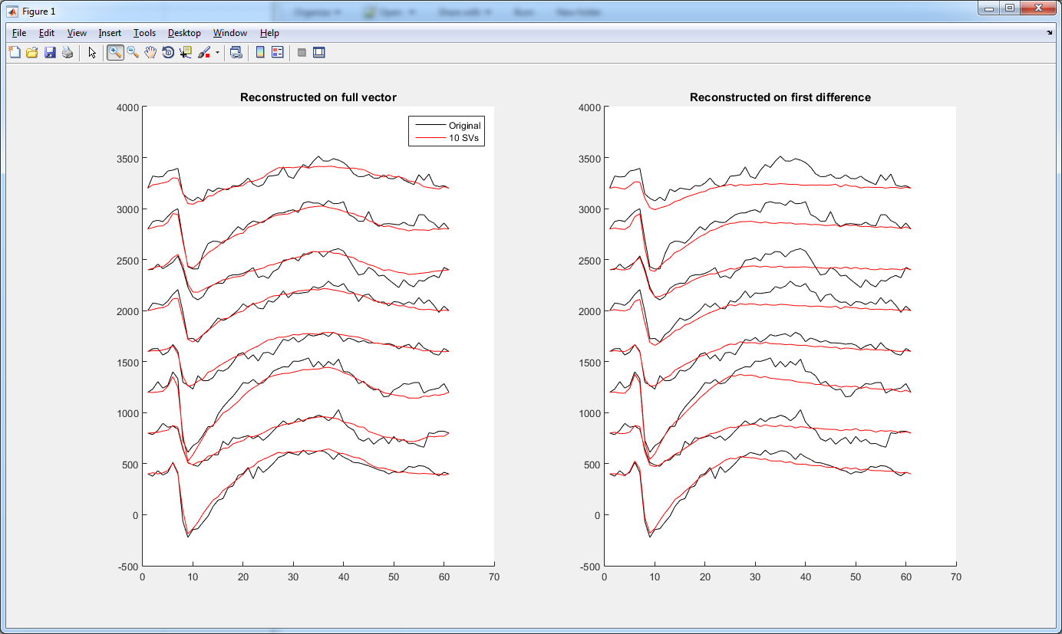
How to emphasize different features
SVD to denoise spike waveforms
Apply to original waveform: fits slow trends as well as fast spike
Diff, fit, then integrate: fits to match derivatives by least squares, emphasizing spike over trend
Cingulate cortex: Nick Steinmetz

Slide 29
If you’re serious…
American Mathematical Monthly 1993

